Slide 1
Analysis of Adverse Effects on Breast cancer Drugs (Tamoxifen and Letrozole).
By
Jyothirmai Vallakati
ID: 11697705

Slide 2
Contents
Introduction
Data Cleaning
Data Segregation
Data Analysis
Results (Visualizations)
Conclusion

Slide 3
Introduction
Tamoxifen(G): It is a type of selective estrogen receptor modulator (SERM), used primary for the treatment and prevention of hormone receptor-positive breast cancer cases. Use: blocks action of estrogen in breast tissue.
Letrozole(G): It is an aromatase inhibitor. Similar usage. Reduces production of estrogen.

Slide 4

Data Cleaning
The data has been taken from the FAERS dashboard for the specific drugs
At first; for each drug – the data downloaded had columns such as patient sex, age, weight, reactions, reasons, case id, product name etc.
The data has been cleaned to remove missing values, duplicate values and outliers.
Final data had only 4 columns mainly patient’s sex, age, weight and reactions
FAERS dashboard link: https://fis.fda.gov/sense/app/95239e26-e0be-42d9-a960-9a5f7f1c25ee/sheet/7a47a261-d58b-4203-a8aa-6d3021737452/state/analysis

Slide 5
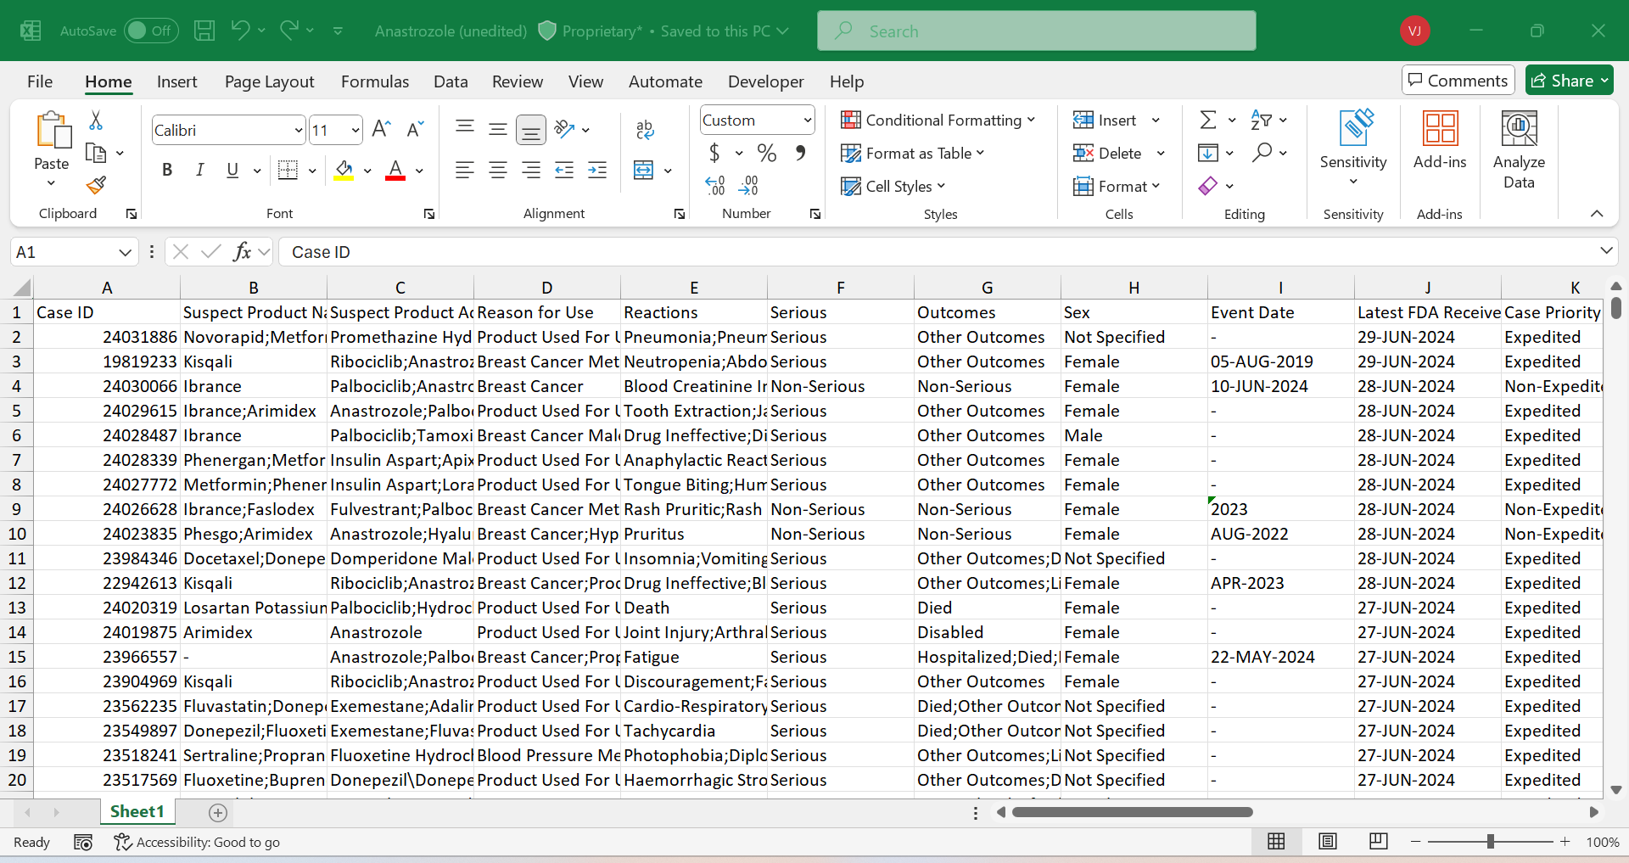


Removing irrelevant and missing values

Slide 6
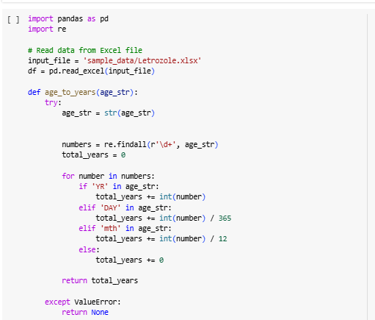
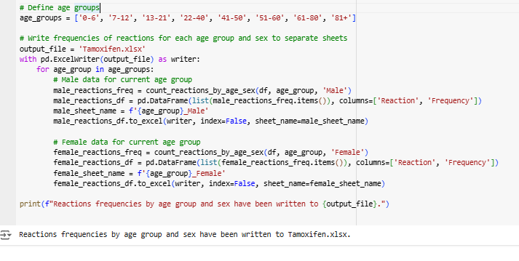
Data Segregation
At this stage, the data has been grouped together using the python code, where the code functions on dividing the data into groups and counting the frequency..
The final output file had values reactions and frequency values for each and every particular age group

Slide 7
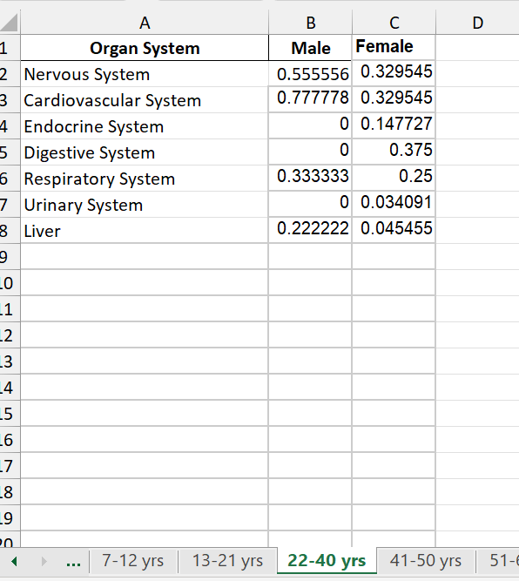
Data Analysis
The segregated data is taken, and the organ system is generated using the Gemini (BERT ).
Later, the sheet has been modified to group together the similar organ systems
Normalization has been calculated on the data using the formula – Normalization= total frequency/ total number of patients
The plots have been plotted based on this data.
Fig: Normalized values

Slide 8
Letrozole Data

Slide 9
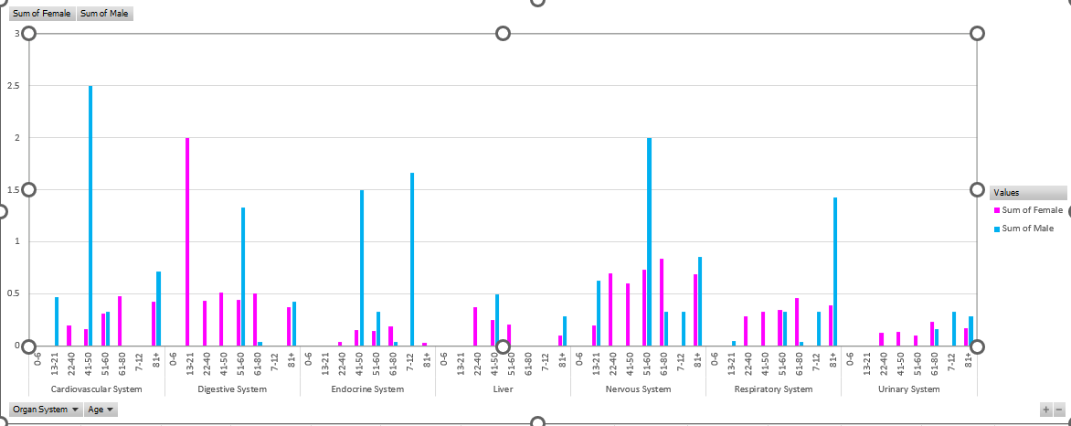
Letrozole (Male vs Female)

Slide 10
Letrozole (Affected Organ systems) Overview

Slide 11
Tamozifen Data

Slide 12
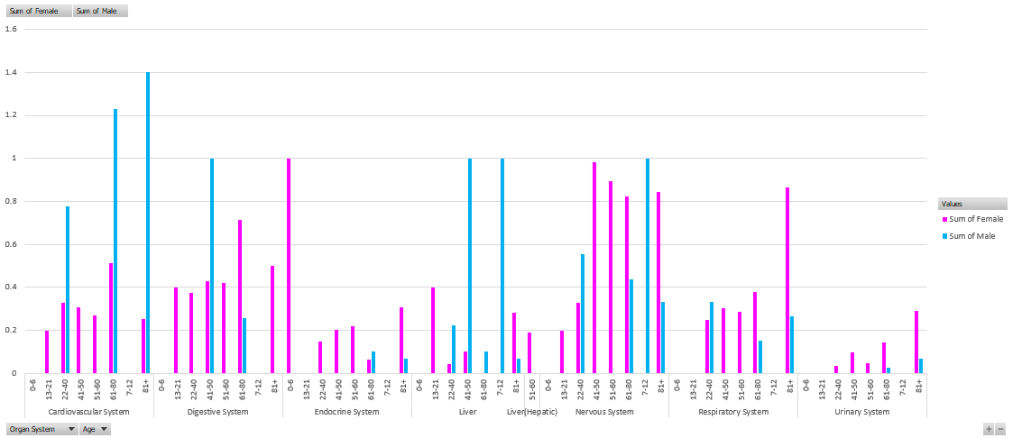
Tamoxifen (Male vs Female)

Slide 13
Tamoxifen Affected Organ systems Overview

Slide 14
Conclusion
As observed for these two drugs, we can say that the effects on females is more than males. We have also seen that near the age group of 45-60 years in female, the reported cases are higher.
The considered data comes from the year 1995 to 2024.
From this information, we can try to come to a final point that the females in that particular age group are affecting more and further the drug formula’s can be modified to decrease the number of reactions in the future.

Slide 15
THANK YOU

